Slide 1

Federal and State Tax Simplification for Fair and Simple Tax Rate and Saving
John Lee
www.taxsimplecenter.com
johnlee@taxsimplecenter.net
913-710-0957

Slide 2
Question and Introduction
1. Basic Question: What tax rates are fair and simple?
2. Americans spend 8.9 billion hours/year to comply with IRS filing requirements and cost $409 billion/year (*Ref)
3. What tax simplification areas are needed to be simplified?
4. What are benefit and value of tax simplification for withholding taxes, payrolls and tax returns?
5. We have done our tax research with 15 publications

Slide 3
Federal Tax and Simplification
Year: … 1970 1980 1985 2000 2010-12 2013-23… 100 years Bracket #: 32 17 16 5 6 7 up to 56
Problems: (1) 21-page Withholding Tables, (2) 224 (4x7x8) tax formulas, (3) 28 (4x7) taxable income ranges, (4) 12- page Tax Table, (5) changeable tax bracket # (2-56), and (6) Complex system and related arguments with high cost
Tax simplification: 2 linear formulas and 1 existing formula with 98.7% (1-3/224) reduction and simple S # and F #
Withholding tables: Do not need

Slide 4
State Taxes and Simplification
State tax bracket #: 0 - 12
Problems: Many states have (1) xx-page Withholding Tables, (2) up to 216 (9x3x8) tax formulas, (3) multiple taxable income ranges, (4) x or xx page Tax Table, and (5) Complex system and related arguments with high cost
Tax simplification: 1 linear formula and 1 existing formula with 95-99% reduction and simple S # and F #
S (status #): 1, 1.5 or 2. F (filling period factor #): 1, …, 365
Withholding tables: No

Slide 5
Basic Question and Solution
What tax rates are fair and simple?
Two-type tax rates and simplification: (1) Existing flat and curve tax rates; (2) Step tax rates; and (3) Simplification with straight (linear) line
Tax rate (2)Step tax rates #2
(3)Straight line
(1)Flat and curve rates (1 bracket: (2020 Stimulus Check:
(Existing 2-11 brackets: Fair and simple) 240/480 brackets)
#1 Unfair & complex) Taxable income

Slide 6
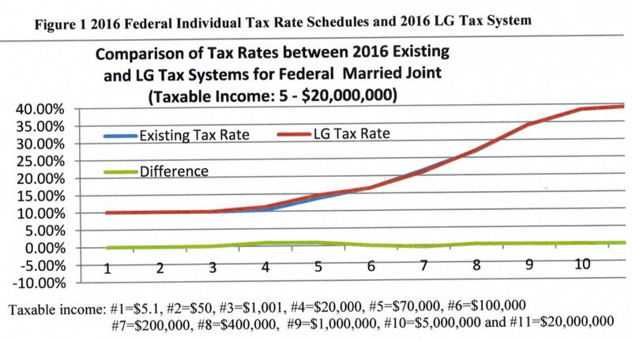
The federal tax system comparisons
7 tax brackets are reduced to 3 (57% reduction) and no W Tables

Slide 7
Comparison
For Married filing separately/Single with taxable incomes (TI) <$100,000, federal tax rate formula, change, withholding table, and difference comparisons are:
(2018: 10-18.3-26.9-37%, 2019:10-18.17-26.73-37% or 2020: 10-18.1-26.6-37%)
Taxable incomes Existing tax rate formula/system Simplification
0 - $9,525 10% for TI not over $9,525 ( 0 - $100,000)
$9,525 - $38,700 (952.5+0.12 (TI-9,525)) / TI
$38,700-$82,500 (4,453.50+0.22(TI-38,700))/TI TIxF/S/1,204,819+0.1
$82,500-$100,000 (14,089.50+0.24(TI-82,500))/TI
Tax rate change Unfair flat/curve rates w/o smoothness Fair tax rates w/smoothness
Withholding Tables 21 pages with 0-10 Allowances 0.2 page with all Allowances
Taxable income $1,000 $20,000 $50,000 $75,000 $100,000
Tax rate difference 0.00083 0.00612 0.00271 - 0.00361 0.00010

Slide 8
Example
A man with Married filing jointly status has two children and house wife. His bi-weekly income is $3,543.21. His tax rate and withholding tax are:
Tax rate = TIxF/1,204,819/S+0.1 (TI=taxable income, F=payroll period, S=status=2)
Withholding/Income tax=(Incomes±Adjustments-(Deductions+Exemptions)/F) Tax rate-Tax credits/F
Biweekly: Tax rate = (Incomex26-24,400)/1,204,819/2+0.1 = 0.128105
Withholding tax = (Income-24,400/26) Tax rate - 2000x2/26 = $179.83
Payroll = Income - Withholding tax - SS tax - Others
He has annual income $92,876.54, interest $2,345.67 and IRA $5,000. Then:
Annual: Tax rate = (92,876.54+2,345.67-5,000-24,400)/1,204,819/2+0.1 = 0.127316
Income tax = (92,876.54+2,345.67-5,000-24,400) Tax rate – 2000x2 = $4,380.24
(Above calculations can be done repeatedly by Excel, Spreadsheet or Software)

Slide 9
What tax simplification areas are needed to be simplified?
1. To match/reduce existing 3-12 tax brackets to 2 or 3, eliminate withholding tables (up to 22 pages) with 0-10 allowances, simplify tax statuses with 1, 2 or 1.5, and provide a checking tool for reducing calculation mistakes;
2. Standard deductions are increased to include exemptions together, which have been done by the Tax Cuts and Jobs Act (2018);
3. Itemized deduction may be simplified/eliminated. Neutral revenue may be reached by reducing top/bottom tax rates with simplification;
4. Various credit, exemption and earned income tax credit for children may be simplified or combined together;
5. Various exemption, credit, retirement distribution, and social security benefit for seniors may be simplified or combined together. Simple ½-page tax return form is provided for seniors’ tax simplification;

Slide 10
What tax simplification areas are needed to be simplified?
6. Alternative Minimum Tax (AMT), which applies to about 4 million tax returns, may be eliminated or simplified;
7. Some "complex" political arguments, which may cause social conflicts, are converted into "simple" technical issues;
8. When 2 rates are set, simple effective (linear) rates between the two points with a straight line are fair and simple, which can be applied for tax rates, social security benefit rates, working family credit rates, homestead credit refund rates, and earned income tax credit rates. Existing flat and curve rates or step (cliff) rates with less or more brackets are unfair and complex; and
9. Existing two tax calculation systems for companies and employees, which are about 13 months apart, can be combined together to simplify into one common system for all related parties to have tax simplification fairly and simply.

Slide 11
Benefit and Value Summary
For Lawmakers: To convert “complex” political factors into “simple” technical factors with less political conflicts
For Taxpayers: Half-page tax return form saves time and cost www.academicstar.us/UploadFile/Picture/2023-5/20235518550488.pdf (Table 3)
For Companies: To eliminate withholding tables (up to 22 pages) for companies to do payrolls and withholding taxes
For Dept of Revenue: To reduce processing time and cost
Benefit and Value: 15 benefits to save $10 billion/year for Federal or $20-900 million/year for a state

Slide 12
Benefit and Value Summary
1. 3 brackets are for Federal or 2 brackets for states
2. Eliminate withholding tables (to 22 pages). If saving $1 for company and $0.2 for Dept of revenue per payroll period from 11 areas*, total saving is $4.8 billion/year (1.2x26x155 million) www.academicstar.us/UploadFile/Picture/2023-5/20235518550488.pdf (Table 7)
3. Tax statuses are simplified with 1, 1.5 or 2 for Single, HH or MJ
4. Provide a checking tool to reduce calculation mistakes
Half-page tax return form for (Seniors’) tax simplification
https://taxsimplecenter.net/publication.html (B8)
15. One tax system for all parties is to replace existing 2 systems

Slide 13
Publication
Our publications for our tax simplification:
Benefits and Values of the LG Tax Simplification for Federal Government, Companies and Taxpayers, Journal of Business and
Economics, 2022, 13(12) 621-633 www.academicstar.us/UploadFile/Picture/2023-5/20235518550488.pdf
Benefits and Values of State LG Tax Simplification for Governments, Businesses and Taxpayers, Journal of Economics, Business and Market Research, 2021, 4, 498-513. www.scitcentral.com/documents/be5648da4795008d9893b752b9226c8f.pdf
The U.S. Personal Income Tax Reform: Linear and Gradual Tax Simplifications, Academy of Economics and Finance Journal, 2013, 4, 47-55. www.economics-finance.org/aefj/issues/AEFJ_volume4.pdf

Slide 14
Publication
US Federal and State Corporate Tax Simplification, Journal of Business and Economics, 2014, 5 (9) 1473-1483. www.academicstar.us/issueshow.asp?daid=929
The U.S. State Personal Tax Simplifications with the LG Tax System, Academy of Economics and Finance Journal, 2014, 5, 59-67. www.economics-finance.org/aefj.php
Option on Filing Exemption for Federal Personal Tax Return with Linear and Gradual Tax System, Academy of Economics and Finance Journal, 2015, 6, 79-86. www.economics-finance.org/aefj.php
The LG Tax System for Federal Individual Income Tax Compliance, Journal of Business and Economics, 2017, 8 (7) 551-561
www.academicstar.us/UploadFile/Picture/2018-1/20181922936274.pdf
www.taxsimplecenter.weebly.com (More Publications)

Slide 15
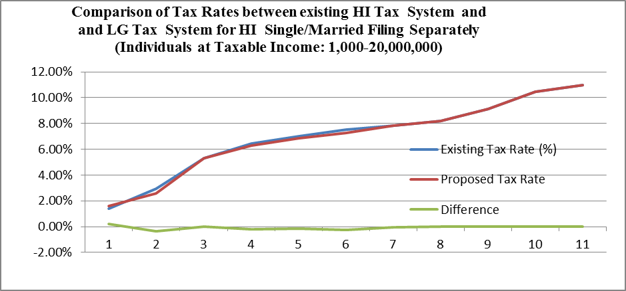
HI Existing and LG Simplification Comparison
12 tax brackets are reduced to 3 (75% reduction) and no W Tables

Slide 16
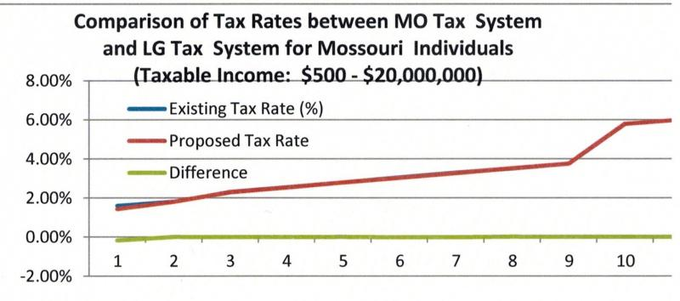
Tax simplification for MO
10 tax brackets are reduced to 2 (80% reduction) and no W Tables

Slide 17
2020 Stimulus Check and Simplification
2020 Stimulus Check Calculation for Individuals & Families: 240/480 steps
Status AGI Payment Rate Step Rate check Budget Analysis
Single 75-99 K $1,200-0 $5/$100 240 No Add together
Family 150-198K $2,400-0 $5/$100 480 No (Complex)
Example: For Single, AGI=87,000, 87,000-75,000=12,000, then
12,000÷100=120 and 120*5=600. Final result=1200 – 600=600
Simplification:
Status AGI Payment Rate Bracket Rate check Budget Analysis
All (75-99 K) S ($1,200-0) S 1 formula 1 Yes (1-0) 1 formula
Rate=1-(AGI÷S-75,000)÷24,000 (check: 1-0 with smooth change)
( Status (S)= 1 for individual or 2 for family )
Example: For Single, AGI=87,000, Final result=1,200*1(1-(87,000÷1-75,000)÷24,000)
=1200*0.5=600
Budget Analysis: If N is for Single numbers, budget analysis is:
1,200 N-0.05 Sum (AGI÷S)n+(1,200x75,000÷24,000) N=4,950 N-0.05 Sum (AGI)n

Slide 18
Conclusion
We have found both fair and simple tax rates to simplify existing two tax calculation systems into one simple system
Match and reduce existing 3-12 brackets to 3 for Federal or 2 for states. The 3 or 2 brackets are kept to reduce related political conflicts (3 factors with various options)
Eliminate withholding tables (up to 22 pages)
Half-page tax return form www.academicstar.us/UploadFile/Picture/2023-5/20235518550488.pdf (Table 3)
15 benefits to save $10 billion/year (value) for Federal or $20-900 million/year (value) for a small-large state

Slide 19
Question and Suggestion
Thank you!
johnlee@taxsimplecenter.net
913-710-0957
www.taxsimplecenter.net

